Slide 1
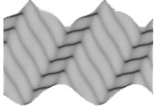
Lecture 1: Methodology of mathematical modelling
Part 1–A: lecture
Part 1–B: examples
E
C NS

Slide 2
Part 1–A: lecture
A mathematics model is a description of a | process system phenomena | using mathematical concepts: | functions algebraic equations differential equations difference equations integral equations
Methodology of mathematical modelling
E
C NS

Slide 3
Methodology:
real world:
real problem
state
physical
formulate
mathematical
observations
improvements
Methodology of mathematical modelling
model
experiments
interpred
and validate
solve
mathematical
E
C NS

Slide 4
Where did modelling start
ancient: astronomy
agriculture
engineering
. . . . .
a need to count
to measure
to sort
to arrange
to eliminate
. . . . .
Methodology of mathematical modelling
E
C NS

Slide 5
Some rules:
LEONARDO DA VINCI
Motion is an accident born from the inequality of weight or force.
Force is the cause of motion, motion is the cause of force.
Observe the phenomenon and list quantities having numerical magnitude that seems to influence it.
Set up linear relations among pairs of these quantities as are not obviously contradicted by experience.
Propose these rules of three trial by experiment.
Methodology of mathematical modelling
E
C NS

Slide 6
ISAAC NEWTON “PRINCIPIA”, 1687
I Every body continues in its state of rest, or of uniform motion straight ahead, unless it be compelled to change that state by forces impressed upon it.
II The change of motion is proportional to the motive force impressed, and it takes place along the right line in which that force is impressed.
III To an action there is always a contrary and equal reaction; or, the mutual actions of two bodies upon each other are always equal and directed to contrary parts
Methodology of mathematical modelling
E
C NS

Slide 7
Physical systems
Biological systems
Social systems
Methodology of mathematical modelling
E
C NS

Slide 8

Physical systems
Balance laws
model
Constitutive equations
Main stages:
Classical dynamics – Newton; Hamilton . . .
Thermodynamics – Carnot, Boltzmann . . .
Dissipative structures – Prigogine, . . .
Methodology of mathematical modelling
E
C NS

Slide 9
kinetic energy – motion
potential energy – Helmholz free energy
balance:
amount at
given time (t) = amount in the past (t - ∆ t)
+ amount which is created (at ∆ t)
- amount which is destroyed (at ∆ t)
+ amount given by influx (at ∆ t)
Methodology of mathematical modelling
E
C NS

Slide 10

Laws of nature:
gravitation $F = \frac{Gm1m2}{r2}$
Coulomb $F = \frac{q1 q2}{r2}$
Derived:
Hooke $σ=E ε$
Ohm RI = U
Fourier q = -$λ \frac{∂T}{∂x}$
. . . .
are these exact?
Methodology of mathematical modelling
E
C NS

Slide 11
Biological systems
specific features:
– energy exchange with the environment
– many chemical reactions, transfer mechanisms
– non-equilibrium systems
Methodology of mathematical modelling
E
C NS

Slide 12
BIOLOGICAL SYSTEMS
information dense
spatially extended
organized in interacting hierarchies
BIOLOGICAL STRUCTURES
intracellular
cellular
tissue
organ
MATHEMATICALLY
coupling of different types of equations
computational difficulties
PHYSICALLY
dissipative character
activity/excitability
spatio-temporal patterning
coupling
Methodology of mathematical modelling
E
C NS

Slide 13
Social systems
Phenomenological laws are absent
Time-series
Threat : wishful thinking
causality? (post hoc, propter hoc)
Nevertheless:
economical models
political models
social coexistence models
. . . .
Methodology of mathematical modelling
E
C NS

Slide 14
Requirements
Requirements to models:
flexibility
parsimony (Occam’s razor)
equipresence
invariance
causality
Important notions:
static versus dynamic
continuous versus discrete
linear versus nonlinear
Methodology of mathematical modelling
E
C NS

Slide 15
Plethora of problems:
climate change
elementary particles
neurons
earthquakes
turbulence
fracture
universe expansion
. . . .
and questions:
cause and effect?
symmetry?
predictability?
. . . .
Methodology of mathematical modelling
E
C NS

Slide 16
Some useful thoughts:
One of the principal objects of theoretical research in any department of knowledge is to find the point of view from which the subject appears in the greatest simplicity.
J.W.Gibbs, 1881
Everything should be made as simple as possible, but not simpler.
A.Einstein
The research worker, in his effort to express the fundamental laws of Nature in mathematical form, should strive mainly for mathematical beauty. It often happens that the requirements of simplicity and beauty are the same, but where they clash the latter must take precedence.
P.Dirac 1939
Methodology of mathematical modelling
E
C NS

Slide 17
Part 1–B: examples
Physical systems
Modelling of wave motion
homogeneous solids – models well-known
microstructures solids – new models developed
Methodology of mathematical modelling
E
C NS

Slide 18
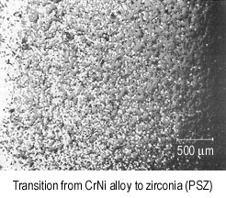
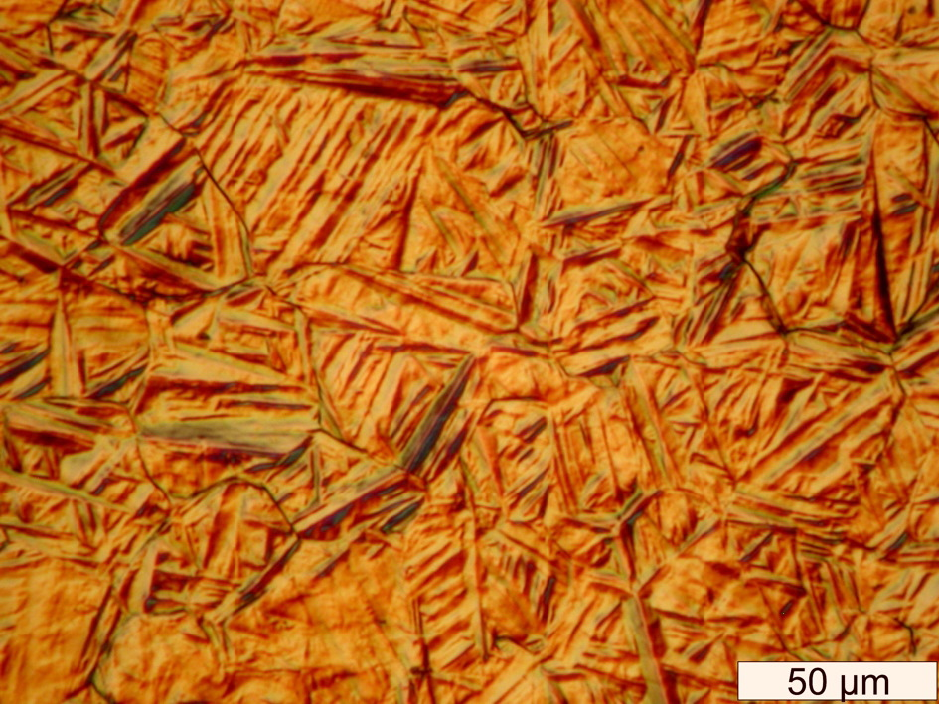
Materials
Microstructured materials
FGM
Methodology of mathematical modelling
Reproduced from: B. Ilschner. Processing-microstructure-property relationships in graded materials. J. Mech. Phys. Solids 44, (1996) 647-656.
Surface relief in Fe-0.44C-0.34Si-0.70Mn-01.10Cr-0.16Ni-0.18Mo wt\% sample. Reproduced from: H. Pantsar. Use of DIC Imaging in Examining Phase Transformations in Diode Laser Transformation Hardening of Steels. 23rd Int. Congress on Applications of Lasers and Electro-optics, San Francisco, CA, USA, 2004
E
C NS

Slide 19
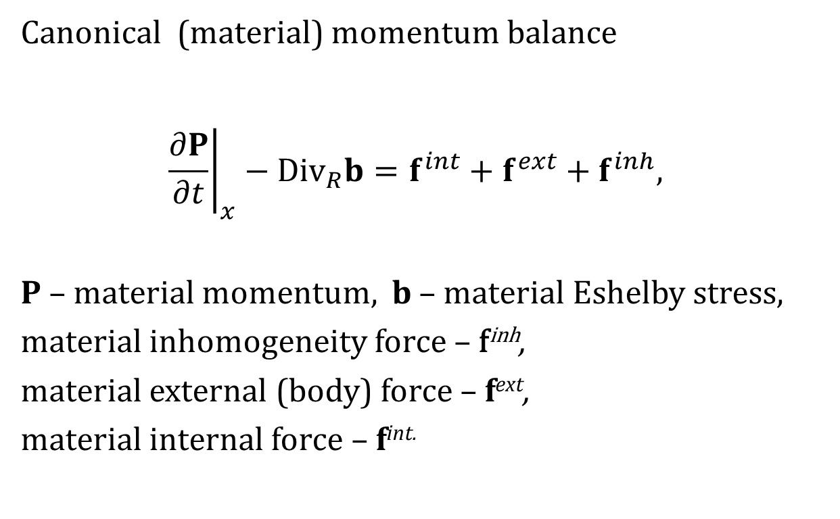
Balance laws
Canonical (material) momentum balance
$${\left.\frac{∂P}{∂t}\right|}_{x}−{Div}_{R}b=f^{int}+f^{ext}+f^{inh},$$
P – material momentum, b – material Eshelby stress,
material inhomogeneity force – f^{inh},
material external (body) force – f^{ext},
material internal force – f^{int.}
Methodology of mathematical modelling
E
C NS

Slide 20
Energy conservation
the second law
Methodology of mathematical modelling
S – the entropy flux, S – the entropy density per unit reference volume, θ – absolute temperature, K – extra entropy flux,
T – the first Piola – Kirchhoff tensor, F – deformation gradient.
E
C NS

Slide 21
Hierarchy of waves
System of two 2nd order equations → one 4 th order equation
Simplified (slaving principle)
Methodology of mathematical modelling
E
C NS

Slide 22
Biological systems
Contraction of the heart muscle
Huxley model
Methodology of mathematical modelling
E
C NS

Slide 23
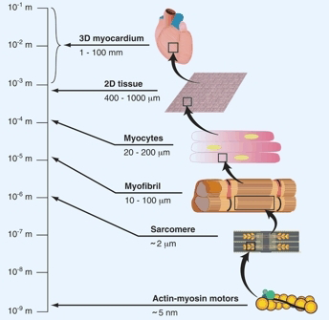
Structural hierarchy of heart muscle
Methodology of mathematical modelling
E
C NS

Slide 24
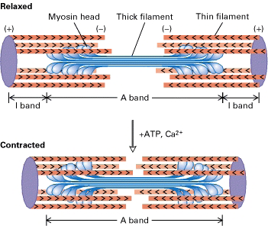
Sliding filaments
Methodology of mathematical modelling
E
C NS

Slide 25
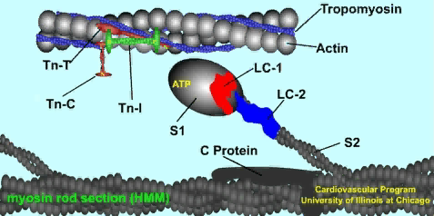
Cross-bridge
Methodology of mathematical modelling
E
C NS

Slide 26
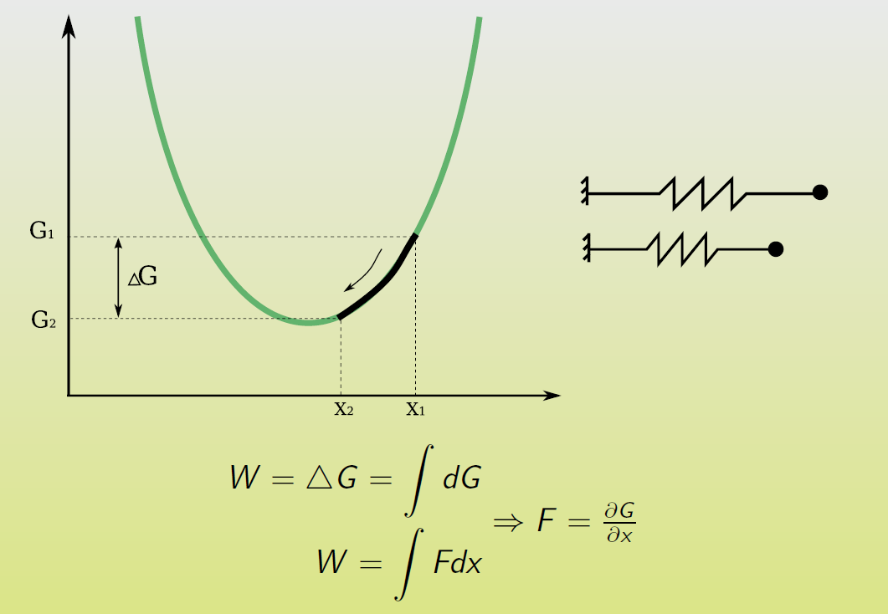
Kinetics
Methodology of mathematical modelling
E
C NS

Slide 27
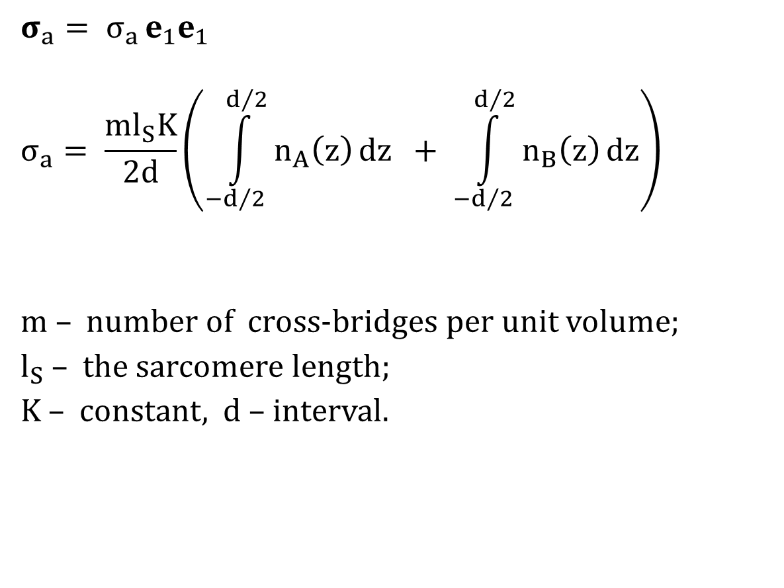
Active stress
$$σ_{a}= σ_{a }e_{1}e_{1}$$
$$σ_{a}= \frac{ml_{S}K}{2d}\left(\int_{−d/2}^{d/2}{n_{A}\left(z\right)}dz + \int_{−d/2}^{d/2}{n_{B}\left(z\right)}dz\right)$$
m $–$ number of cross-bridges per unit volume;
$l_{S}$ $–$ the sarcomere length;
K $–$ constant, $d –$ interval.
Methodology of mathematical modelling
E
C NS

Slide 28

Model (1)
$$\frac{∂n_{A}}{∂t}+w\frac{∂n_{A}}{∂z}= f_{1}n_{C}+ g_{2}n_{B}− \left(g_{1}+ f_{2}\right)n_{A},$$
$$\frac{∂n_{B}}{∂t}+w\frac{∂n_{B}}{∂z}= f_{2}n_{A}− \left(g_{2}+ f_{3}\right)n_{B}$$
Methodology of mathematical modelling
E
C NS

Slide 29
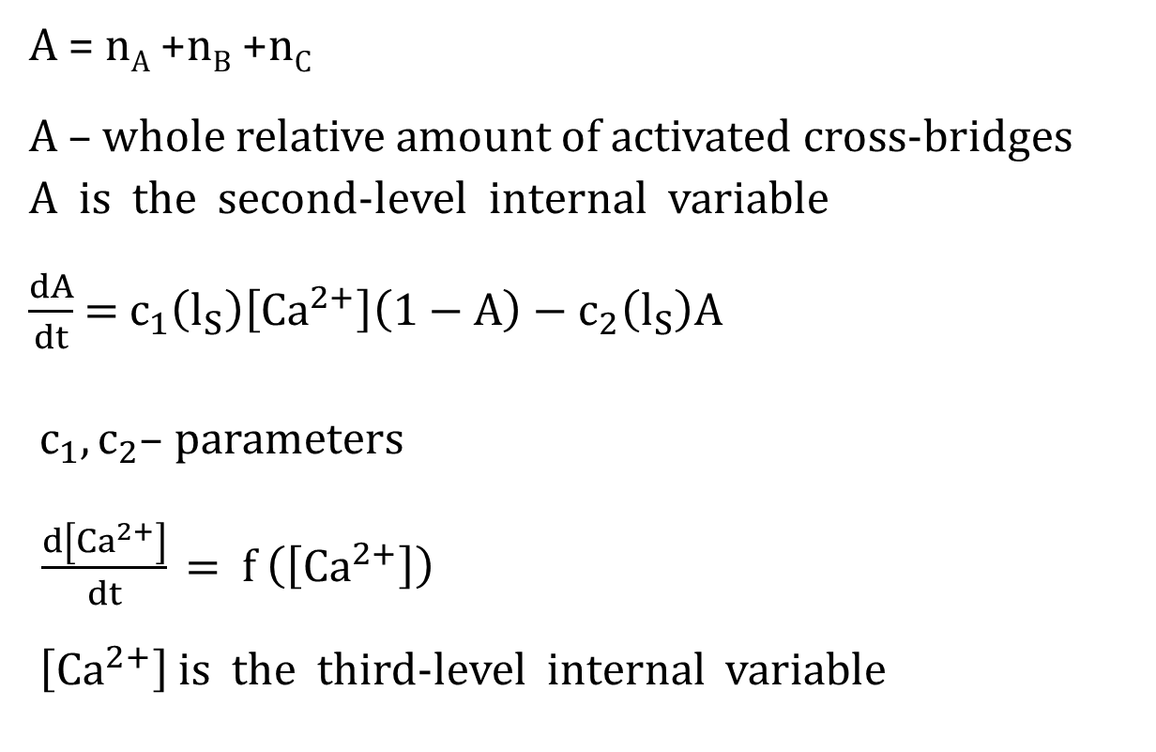
Model (2)
A = n_{A} +n_{B} +n_{C}
A – whole relative amount of activated cross-bridges
A is the second-level internal variable
$\frac{dA}{dt}$ = $c_{1}\left(l_{S}\right)\left[{Ca}^{2+}\right]\left(1−A\right)$ $−$ $c_{2}\left(l_{S}\right)A$
${ c}_{1}, c_{2}\text{–}$ parameters
$\frac{d\left[{Ca}^{2+}\right]}{dt}\text{ =} \text{f} \left(\left[{Ca}^{2+}\right]\right)$
$\left[{Ca}^{2+}\right]$ is the third-level internal variable
Methodology of mathematical modelling
E
C NS

Slide 30
Social systems
Economy
Elections
Methodology of mathematical modelling
E
C NS

Slide 31
The Black-Scholes model (1)
Assumptions
  these is no way to make a riskless profit
  it is possible to borrow and lend cash at a
  constant risk-free interest rate
  it is possible to buy and sell any amount
  the above transactions do not incure any fees
  the stock price follows a geometric Brownian motion
  the underlying security does not pay a dividend
Methodology of mathematical modelling
E
C NS

Slide 32
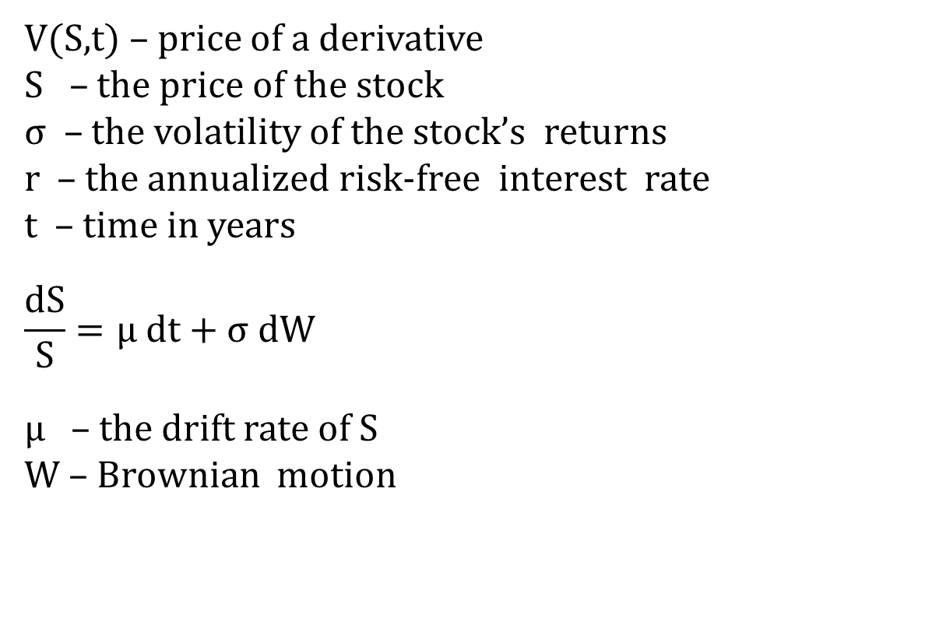
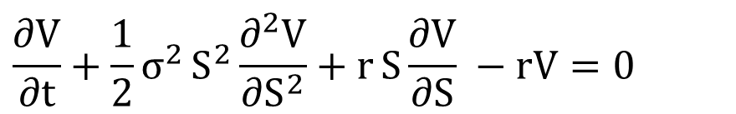
The Black-Scholes model (2)
$$\frac{∂V}{∂t}+\frac{1}{2}σ^{2}{S^{2}\frac{∂^{2}V}{∂S^{2}}}+rS{\frac{∂V}{∂S} −rV=0 }$$
V(S,t) – price of a derivative
S – the price of the stock
σ – the volatility of the stock’s returns
r – the annualized risk-free interest rate
t – time in years
$$\frac{dS}{S}=μ dt+σ dW$$
μ – the drift rate of S
W – Brownian motion
Methodology of mathematical modelling
E
C NS

Slide 33
Election of the doge in Venice, 1268
Ca 800
approval
Doge
lots
election
Methodology of mathematical modelling
30
40
25
45
41
election
election
election
election
lots
lots
lots
lots
9
12
9
11
E
C NS

